Slide 1
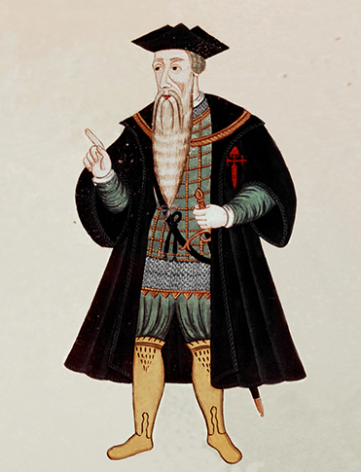
New Global Connections (1415-1796)
Lesson 2 Europeans Gain Footholds in Asia

Slide 2
New Global Connections (1415-1796)
Topic 5 Lesson 2 Europeans Gain Footholds in Asia
Key Terms
Afonso de Albuquerque’s
Mughal empire
Goa
Malacca
outposts,
Dutch East India Company.
sovereign
Philippines.
sepoys,
Macao
Guangzhou
Matteo Ricci
Manchus
Qing
Qianlong
Lord Macartney
Tokugawa
Nagasaki

Slide 3
New Global Connections (1415-1796)
Topic 5 Lesson 2 Europeans Gain Footholds in Asia
Learning Objectives
Summarize how Portugal built a trading empire in South and Southeast Asia.
Analyze the rise of Dutch and Spanish dominance in Asia and the Indian Ocean.
Understand how the decline of Mughal India affected European traders in the region.
Describe European contacts with Ming and Qing China.
Summarize Korea’s and Japan’s attitudes toward contact with the outside world.

Slide 4
Portugal Builds an Empire in Asia
Albuquerque in India
Admiral Afonso de Alburquerque is going to set up Portuguese operations in India. He will get India’s Southern Princes to help him by promising aid against other Europeans
Trading Outposts Around the Indian Ocean
1510 Port. take the island of Goa
1511 they take East Indies port of Malacca in Malaysia
East African cities will be used to resupply and repair ships
In less than 50 years will control the spice trade between Europe and Asia
Limits Impact
Portugal did not have the strength or resources to conquer much territory on land. In India and China they sought permission to trade. Their power will decline in the late 1500’s
Port. missionaries caused resentments by attacking Muslims, destroying Hindu temples, and introduced Inquisition

Slide 5
Portugal Builds an Empire in Asia
The experienced general and admiral Afonso de Albuquerque spearheaded Portugal’s efforts to build a trade empire around the Indian Ocean.

Slide 6
Rise of the Dutch and the Spanish
Dutch Sea Power
1599 Dutch fleet returns from Asia with spices, leading to a frenzy of overseas activities. They will create colonies and trading posts around the world including a strategic settlement in Cape Town
The Dutch Dominate Indian Ocean Trade
1602 Dutch merchants form the Dutch East India Company
It will have sovereign powers: build armies, wage war, negotiate peace treaties, and govern overseas territories
1641 Dutch will take Malacca from Portuguese, open trade with China, and enforce a monopoly in the Spice Islands
Spain Captures the Philippines
50 years after Magellan, Spain will conquer and colonize the islands, naming them after Phillip II
The Spanish will try to convert Filipinos and later the Chinese and Japanese

Slide 7
Rise of the Dutch and the Spanish
The Spanish Trade Network
The Philippines became very important to the Spanish trade network. Gold and silver mined from South America traveled across the Pacific Ocean to the Philippines to be used to buy goods in China.

Slide 8
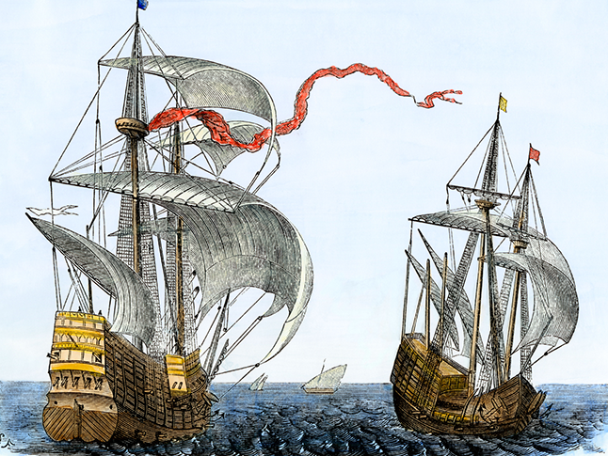
Rise of the Dutch and the Spanish
This hand-colored woodcut illustration shows Dutch merchant galleons at sea during the 1600s. Note these ships’ great storage capacity for trade goods.

Slide 9
Europeans Trade in Mughal India
A Thriving Trade Center
Mughal empire was the larger, richer, and more powerful empire than any European power so when they asked for trading rights the Mughal allowed it. They have spices and textile that the Europeans wants. They will allow Europeans to build forts and warehouses in coastal Indian towns
Turmoil and Decline
The Mughal empire will weaken b/c of religious intolerance increasing which leads to civil wars between Muslim and Hindu princes which lead to higher taxes, which leads to peasant rebellions. Corruption becomes widespread and central govt. fades
British-French Rivalry in India
English and French merchants will set up their own East India companies, make alliances with rajahs, and make their own army
In the 1700’s England and France will fight for global dominance and it will lead to the British EIC using troops to drive out the French

Slide 10
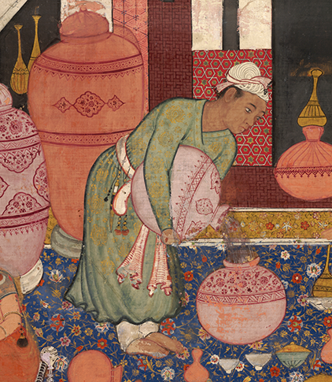
Europeans Trade in Mughal India
In this Mughal illustration painted on fine cotton, a servant is at work, standing on a richly decorated carpet. Indian carpets and other textiles were highly prized trade goods.

Slide 11
Ming China and Europe
Trade with Ming China
The Portuguese wanted Chinese silks and porcelains but the Chinese didn’t want Portuguese good so they only took gold or silver. The Ming will allow Europeans to trade with them only in Macao under the supervision of Imperial officials for a certain amount of time. Afterwards they had to sail away
Christian Missionaries
Portuguese missionaries and later Jesuits came with merchants to China. The Chinese liked the Jesuits as they learned many things about the Ren from them.
Jesuits made friends with the elites in hopes of converting them to Christianity and then having those elites convert others
However the Jesuits will have little success in converting them

Slide 12
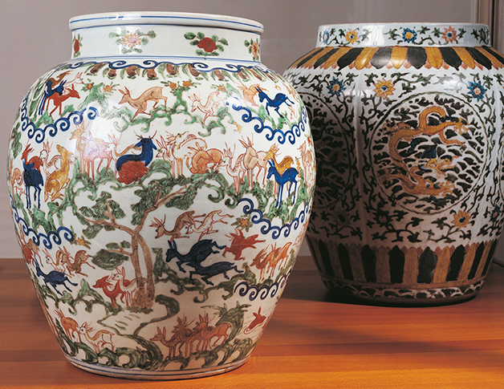
Ming China and Europe
Europeans desired fine Ming goods, such as porcelain vases with intricate designs.

Slide 13
The Manchus Conquer China
The Qing Dynasty Rises
Manchu’s will conquer and create the Qing dynasty
They will adopt the Confucian system of government, will have one Chinese and one Manchu for each top govt. position
Kangxi (1661-1722) extended Chines power into Central Asia
Qianlong, (1736-1796) Kangxi grandson, expanded China’s borders to rule the largest area in the nation’s history
Peace and Prosperity Spread
Economy will expand under both emperors
Potato and corn will be introduced from America, increasing food supply. This will increase population
140 million people in 1740 to over 300 million by 1800.
Silk, cotton, and porcelain industries expanded and so did demand

Slide 14
The Manchus Conquer China
The Qing Limit Foreign Traders
The Qing will still limit traders like the Ming
1793 the British will send Lord Macartney as part of a trade delegation. It will end in a disaster
Short term it’s not a big deal for China, England is far away and they are the most powerful empire in the world.
Long term it is a disaster because there is a lot to learn from the west including military technology

Slide 15
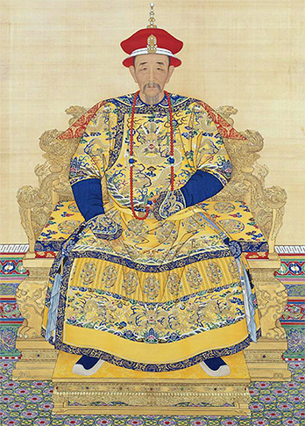
The Manchus Conquer China
A brightly colored formal portrait of the Kangxi, Emperor of the Qing dynasty. Kangxi ascended the throne as a boy and reigned from 1662 to 1722.

Slide 16
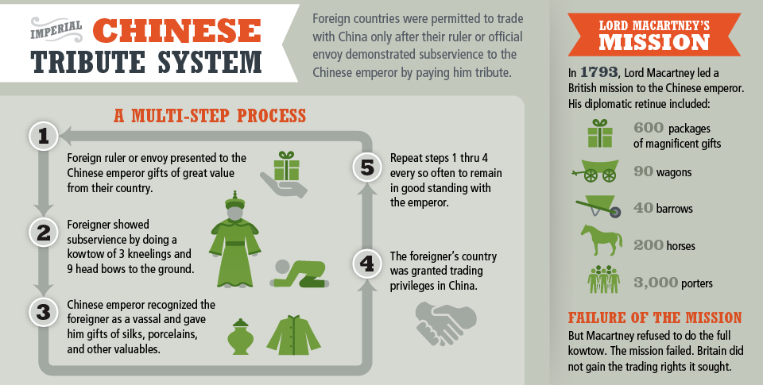
The Manchus Conquer China
European trade activities in China were strictly limited. Only countries that observed the rules of the imperial tribute system could hope for permission to trade.

Slide 17
Korea and Japan Choose Isolation
Invaders Attack Korea
1592 and 1597 Japan invades Korea, Korea drives them out in 1598 but is hurt. Famine and disease is widespread
1636 the Manchu invade and Korea is forced to become a tributary state and acknowledge China’s supremacy
Korea Limits Contact With the World
After the two invasion Korea will adopt a policy of isolation
Korea will arrest any European shipwrecked as spies and will isolate for about 250 years. They will send people out however and learn from maps and books on scientific achievement
Westerners Arrive in Japan
1543 Portuguese arrive to Japan followed by Spanish, Dutch, and English. They are all welcomed
They come at a time where the daimyo’s are fighting for power and introduce firearms. This will help the Tokugawa’s centralize power and impose order

Slide 18
Korea and Japan Choose Isolation
Westerners Arrive in Japan
Japan is more open to Christian missionaries and will adopt Christianity. They will also marvel at the printing press that the Jesuits bring
Tokugawa shoguns will turn on the missionaries and expel them when they find out the Spanish has taken over the Philippines
They are afraid that the Japanese will be more for the Pope than them so thousands are persecuted and killed
Tokugawas Bar Foreigners
By 1638 Tokugawas will bar foreign merchants as well. They will not allow Japanese citizens to travel, outlaw building large ships.
They will allow one or two Dutch ships to trade once a year at Nagasaki.
They will be isolated for 200 years, their arts and literature will grow. Their population will also increase with Edo (Tokyo) having over a million inhabitants by the early 1700’s.

Slide 19
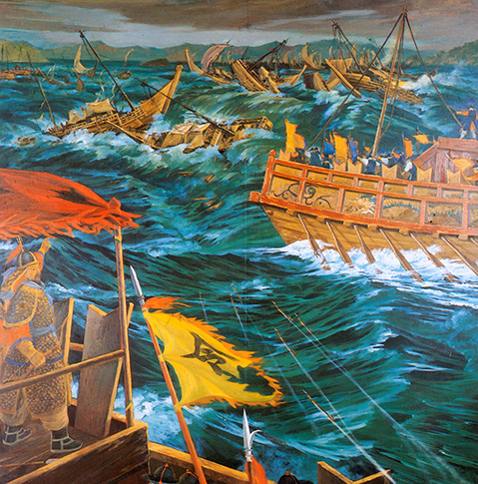
Korea and Japan Choose Isolation
Outnumbered Korean ships destroy an invading Japanese fleet at the Battle of Myeongnyang in 1597, as depicted by an artist in the 1900s.

Slide 20
Quiz: Portugal Builds an Empire in Asia
How did the Portuguese use geographic factors to help them control the spice trade?
A. They used overwhelming force and conquered inland kingdoms, which they turned into a trading empire.
B. They used force and diplomacy to set up coastal trading posts and seize key ports around the Indian Ocean.
C. They used shrewd diplomacy to establish a network of alliances with inland Indian rulers and Arab traders.
D. They used European technology and vastly expanded agricultural production to set up a trading empire.

Slide 21
Quiz: Rise of the Dutch and the Spanish
Unlike most Spanish and Portuguese traders in East Asia, most Dutch East India Company traders
A. wanted to spread Christianity to East Asia.
B. sailed around the Indian Ocean in search of spices.
C. used force and diplomacy to seize coastal towns.
D. worked for a trading company with sovereign powers.

Slide 22
Quiz: Europeans Trade in Mughal India
What did the British East India Company do to dominate most of India?
A. encouraged Mughal emperors to make destructive political decisions
B. used alliances, armies, and its wealth to weaken the Mughal empire
C. used diplomacy to unite Hindus and Muslims
D. partnered with the French to exclude Mughal goods from Europe

Slide 23
Quiz: Ming China and Europe
Why did Ming China demand that Europeans pay for goods with gold or silver?
A. The Ming needed money to pay for European goods.
B. No Ming trade items interested Europeans.
C. The Ming lacked access to precious metals.
D. No European trade items interested them.

Slide 24
Quiz: The Manchus Conquer China
How did the Qing emperor respond to Britain’s diplomatic mission?
A. Lord Macartney and the Qing emperor discussed Britain’s requests and agreed on increased trade.
B. The Qing emperor received Lord Macartney but rejected Britain’s requests for trade.
C. Lord Macartney misunderstood Qing court manners, insulted the emperor, and war resulted.
D. The Qing emperor and Lord Macartney disagreed but scheduled future talks.

Slide 25
Quiz: Korea and Japan Choose Isolation
Both Korea and Japan followed a policy of isolationism because
A. they thought Europeans and other foreigners were a threat to their independence.
B. they did not respect the power of European rulers.
C. they had close ties to China and followed China’s wishes.
D. they had no interest in new ideas and technology.

